Slide 1



countof_records_rating_4.6-5
View in Power BI
Last data refresh:
13/11/2021 15:10:48 UTC
Downloaded at:
13/11/2021 15:28:16 UTC

Slide 2
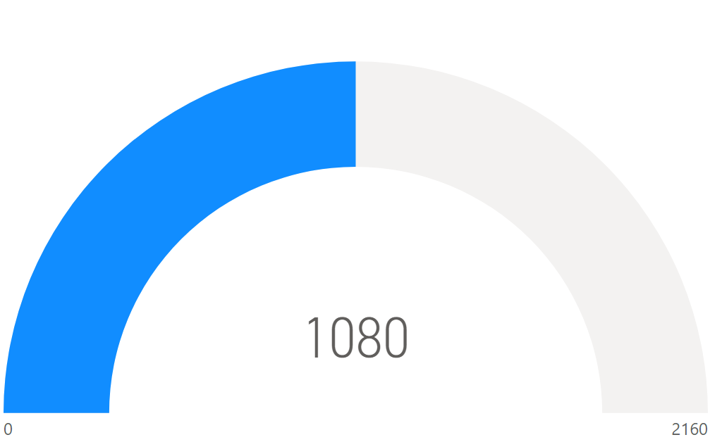
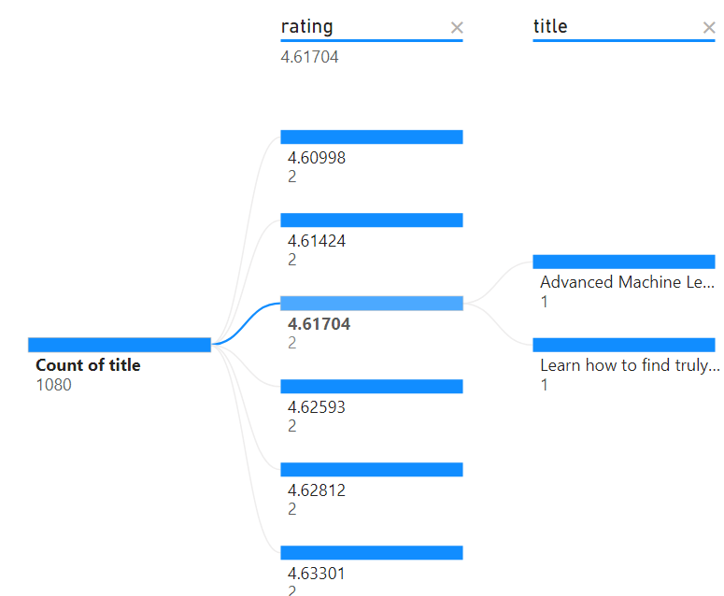
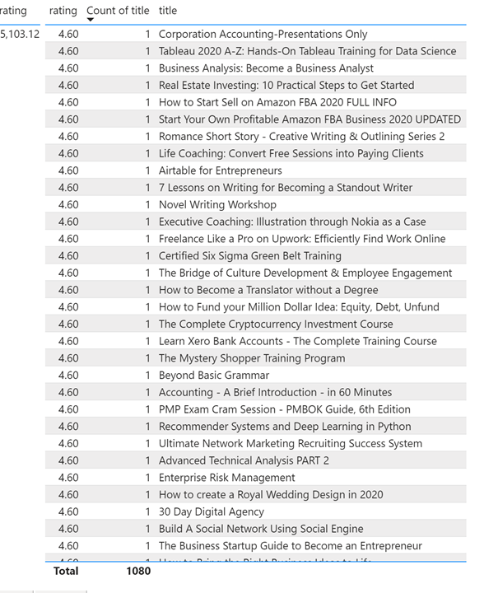
Page 1
The table visual on the right represents data from the Udemy 10 k courses under Business category.
The visual represents count of the total courses rating 4.6-5, which is 1080.
The gauge visuals above shows the total count of this rating range , which is 1080.
Decomposition tree shows the total count of the title for the rating 4.6-5 and also count of title per rating the above range.
The table visuals represents the total count of the courses based on the above rating along with the title of some of the courses and count per rating.
Notes:
tableEx
No alt text provided.
tableEx
No alt text provided.

